Slide 1

“Backsliding into Legalism ”
3:1 – 14
Week 6
23 February 2022

Slide 2


Slide 3

Galatians Ch 3 Overview
With a defense of his apostleship behind him, Paul spends the next two chapters defending the gospel he received by revelation. It is a gospel which proclaims justification by faith in Christ, not by keeping the works of the Law.
As support, Paul begins by providing a personal argument, asking the Galatians to recall how they themselves had received the Spirit, and from Whom. That it came not by the works of the Law but through the hearing of faith should be obvious to them. If they were so begun in the Spirit, why seek to be made perfect by the flesh (1-5)?

Slide 4
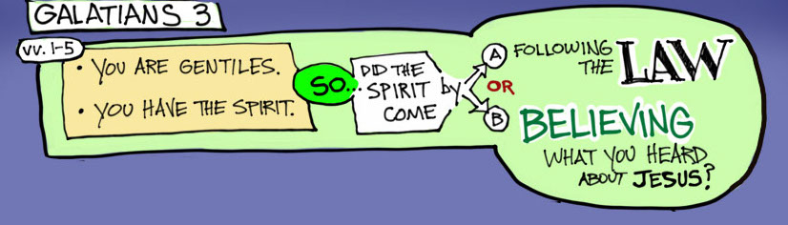
Galatians Ch 3 Overview

Slide 5
Galatians Ch 3 Overview
For his next argument, Paul appeals to the Scriptures. First, Genesis 15:6 reveals that Abraham’s faith was accounted to him as righteousness, and Genesis 12:3 foretold that in Abraham all the nations would be blessed. Therefore, those who are of faith are sons of Abraham and blessed along with him (6-9).
As for the Law itself, the Scriptures reveal that those who are of the works of the Law are under a curse, while proclaiming that the just shall live by faith (Deut 27:26; Habb 2:4). Christ, however, has redeemed us from the curse of the Law and made it possible for the blessing of Abraham to come upon the Gentiles, especially that the promise of the Spirit might be received through faith (10-14).

Slide 6
Galatians Ch 3 Overview
Continuing in his argument from the Scriptures, Paul reminds them that the covenantal nature of the promise made to Abraham means it cannot be broken. Therefore, the promise (along with its inheritance) to Abraham and His “Seed” (Christ) remained firm, even when the Law came along 430 years later (15-18).
What was the purpose of the Law then? Paul answers that it was added because of transgressions until the Seed (Christ) should come. It was not against the promises of God, but because it could not provide life itself, it served the purpose of confining all under sin until the promise by faith in Jesus could be given to those who believe (19-22).

Slide 7
Galatians Ch 3 Overview
Thus the law served to keep them under guard, kept for the faith which would afterward be revealed. To put it another way, it was like a tutor leading them to Christ where they could be justified by faith. Once faith had arrived, the tutor was no longer over them (23-25).
Paul then proceeds with a practical argument to prove we are justified by faith in Christ, which will be continued on into the fourth chapter. Through faith they have become sons of God in Christ, for in being baptized into Christ they had put on Christ (26-27).

Slide 8
Galatians Ch 3 Overview
Being in Christ, they are now one in Him, with all racial, social, and sexual distinctions removed as it pertains to salvation. Being in Christ also makes them Abraham’s seed and thereby heirs according to the promise God made to him (28-29).

Slide 9

Backsliding into Legalism

Slide 10
Galatians Background
How would you feel if your vehicle suddenly lost power on the way up a steep mountain road? With an ache in your stomach, you would pull every lever and push hard on the brake pedal as your car began to roll backward down the hill.
Or imagine sitting on a roller coaster as it click-clack-click-clacks its way to the top of the first crest, only to stop suddenly at the peak and begin to move backward—clack-click-clack-click.

Slide 11
Galatians Background
Or picture yourself climbing a mountainside, linked to several climbers above you with a nylon rope. Everything goes well as the team slowly advances one hand and one foot at a time. Then, from several yards above, you hear the crunch of gravel, the tumble of rocks, and the word you never want to hear echoing from the side of a mountain: “Fall!”
These frightening scenarios are the stuff of nightmares. Nobody wants to backslide. What a horrible term! I can’t imagine a context in which backsliding would be a good thing. The words “backslider” and “backsliding” are found just over a dozen times in the King James Bible, mostly in the book of Jeremiah.

Slide 12
Galatians Background
The term means “to apostatize,” “turn away,” “reverse a positive course,” or “fall into a slump.” Backsliding is not limited to grossly sinful acts. Christians can also backslide into false teaching and the error of extremism—any belief or behavior that deviates from a balanced and healthy Christian life.
The letter to the Galatians is all about this kind of backsliding. The Galatians had not fallen into immorality or defected into paganism. No, their departure from the truth was far more insidious than such obvious apostasies.

Slide 13
Galatians Background
The Galatian believers willingly and deliberately turned away from the grace of the gospel—an act of spiritual treason dressed in the garb of purity and piety!
In short, the Galatians were guilty of backsliding into legalism. Let’s take a close look at Paul’s response to this betrayal of salvation by grace through faith so we can avoid falling into the same error.

Slide 14
Galatians 3:1 – 5
¹You foolish Galatians! Who has bewitched you? Before your very eyes Jesus Christ was clearly portrayed as crucified. ²I would like to learn just one thing from you: Did you receive the Spirit by the works of the law, or by believing what you heard? ³Are you so foolish? After beginning by means of the Spirit, are you now trying to finish by means of the flesh? ⁴Have you experienced so much in vain—if it really was in vain? ⁵So again I ask, does God give you his Spirit and work miracles among you by the works of the law, or by your believing what you heard?

Slide 15
Galatians 3:1 – 5
In Christian circles, legalism frequently springs from dark alleys like a thief, seeking to rob believers of two priceless doctrines: justification and sanctification. The legalistic assault on justification says, “You need to add to Christ’s redemptive work on the cross so God will accept you into His family. You have the ability in and of yourself to meet God halfway, to add to His grace, to pull yourself up by your bootstraps!
The legalistic attack on sanctification is more subtle. Assailants in this camp admit that we are saved by grace through faith, but they claim that once saved we must work hard to please God as we continue in the Christian life.

Slide 16
Galatians 3:1 – 5
They say, “God did His part to save me; now I need to pick up the baton and run well. When I do good works, God smiles; when I let Him down, He frowns. So my spiritual growth depends on working as hard as I can to please Him.”
If that view of sanctification were to take control of our churches, instead of “Jesus Paid It All,” we’d be singing, “Jesus paid a lot, a lot is left to pay! Since the bill is infinite, I’ll work ‘til Judgment Day!” In both legalistic justification and legalistic sanctification, we focus on self. We depend on our own strength rather than God’s power either to save us or to mature us in the Christian life. When that happens, we almost always emphasize the outward appearance rather than the inward reality.

Slide 17
Galatians 3:1 – 5
The Galatian Christians had become victims of both heresies, so Paul argues that Christians receive the entire salvation package by grace alone through faith alone in Christ alone. The same Holy Spirit who regenerates our inner beings, changing dead sinners into living saints, continues His transforming work as we release our will to His and allow Him to live His life through us.
Yet the gift of salvation doesn’t stop there. In fact, though we talk about one day dying and going to heaven, even that glorious experience isn’t the ultimate end of our salvation. Just as God raised us from spiritual death at the moment of our justification, one day God will raise even our physical bodies from the dead, transforming our mortal . . .

Slide 18
Galatians 3:1 – 5
. . . our mortal bodies into glorious bodies and enabling us to live forever in Christ’s kingdom (1Cor. 15:51-54; 1Thes. 4:14-17). Every dimension of salvation—past, present, and future—comes to us by grace through faith. We participate by submitting and receiving, not by controlling and completing.
Our salvation, from beginning to end, is the work of the sovereign Father, through the mediating person and work of Jesus Christ, by the finishing work of the Holy Spirit. We are the recipients, the objects of His grace and mercy. Our responsibility? To receive this free gift by faith: “By grace through faith, from the Father, through the Son, and by the Holy Spirit.”

Slide 19
Galatians 3:1 – 5
These facts of the gospel are so simple and so vital that only fools would learn the principles only to forget or reject them. This explains why Paul pulls no punches in his sharp rebuke of the Galatians: “You foolish Galatians, who has bewitched you, before whose eyes Jesus Christ was publicly portrayed as crucified?” (3:1).
The Greek word translated “foolish” describes mindless, thoughtless, or ignorant actions. In other words, the Galatians must be out of their minds to turn away from Christ’s once-for-all sacrifice for sin! How insane of them to turn instead to their own self-sacrificial living to compensate for whatever they believed Christ’s death was lacking!

Slide 20
Galatians 3:1 – 5
What caused the believers to backslide so foolishly into legalism? Paul says they were “bewitched,” a term implying the casting of a spell or hex on someone. Paul’s point is clear: only somebody “under the influence” of a spiritual power would abandon the doctrine of salvation by grace through faith.
So potent was the legalists’ deception that they were able to perform what amounted to an illusion. Like an illusionist who, by sleight of hand, cunningly diverts the eyes of his audience as he replaces one object with another, the legalist had pulled the Galatians’ attention away from the true focus of their salvation—Christ’s person and work—to something else entirely: the Law and their own works.

Slide 21
Galatians 3:1 – 5
After rebuking the Galatians, Paul poses a series of rhetorical questions designed to reveal the utter folly of their legalism. He first reminds them that they did not receive the Spirit by the works of the Law, but by simply hearing the gospel and responding in faith (3:2). All of his readers knew that they had received the gift of the Holy Spirit immediately upon believing the gospel and putting their trust in Christ. Their personal experience of salvation bore this out.
Yet Paul builds on the fact that the Spirit entered their lives by grace through faith alone with its logical implication: if they began their salvation by the Spirit, they cannot be made perfect by the flesh (3:3).

Slide 22
Galatians 3:1 – 5
Paul’s point is that the Spirit came to indwell the Galatians by faith. That same Spirit is working in them, enabling them to grow in the Christian life. Why, then, would they replace the work of the Spirit with living in the power of their own works?
Paul couldn’t be clearer that the continuation of the Christian life (sanctification) is just as much a result of grace through faith apart from works as the beginning of the Christian life (justification). That is, as we have noted earlier, grace is the way to life and they way of life.

Slide 23
Galatians 3:1 – 5
Paul then appeals to yet another aspect of the Galatians’ early experience as believers in Christ. After their conversion to Christ, they had endured persecution. We catch a glimpse of this persecution in the book of Acts. As the gospel of grace spread throughout the region around the city of Pisidian Antioch (Acts 13:49), “the Jews incited the devout women of prominence and the leading men of the city, and instigated a persecution against Paul and Barnabas, and drove them out of their district” (Acts 13:50).
We can safely assume that once Paul and Barnabas had been driven from the city, the official persecution continued and, perhaps, intensified.

Slide 24
Galatians 3:1 – 5
This would have made it difficult for the Christians in this region “to continue in the grace of God” as Paul and Barnabas had urged them to do (Acts 13:43).
As the missionary team penetrated deeper into the province of Galatia, to Iconium, many Jews and Gentiles believed (Acts 14:1). But “the Jews who disbelieved stirred up the minds of the Gentiles and embittered them against the brethren” (Acts 14:2). As a result, the leaders of the city, both Jews and Gentiles, conspired to persecute Paul and Barnabas (Acts 14:5). No doubt they continued to inflict hardship on the believers in Iconium after the apostle departed.

Slide 25
Galatians 3:1 – 5
At his next stop, Lystra, Paul was stoned and left for dead (Acts 14:19). Clearly, persecution followed on the heels of the gospel, and the first converts to Christ in Galatia experienced their fair share of hardship. For this reason, Paul and Barnabas retraced their steps through the cities of Galatia, “strengthening the souls of the disciples, encouraging them to continue in the faith, and saying, ‘Through many tribulations we must enter the kingdom of God’” (Acts 14:22).
In light of these early days of suffering for the gospel of salvation by grace through faith, Paul demands of his Galatian readers, “Did you suffer so many thins in vain?” (3:4).

Slide 26
Galatians 3:1 – 5
The Galatians had endured all their persecutions because they had wholeheartedly embraced Paul’s message of grace. If they put themselves back under the Law, the persecution would cease—but at the cost of betraying the gospel!
Paul adds one more plank to his already-sturdy argument against the Galatians’ legalistic backsliding. He appeals to the amazing signs and wonders that God had performed at the hands of the apostles of grace when they had preached the gospel to them.

Slide 27
Galatians 3:1 – 5
Acts 14:3 says, “So Paul and Barnabas spent considerable time there [in Iconium] , speaking boldly for the Lord, who confirmed the message of his grace by enabling them to perform signs and wonders.”
Note that the Lord Himself confirmed the message of the apostles, the “word of His grace.” If the Galatians then abandoned this message, they were turning against God’s own testimony regarding its truthfulness!
No wonder Paul called the Galatians “foolish”!

Slide 28
Galatians 3:6 – 9
⁶So also Abraham “believed God, and it was credited to him as righteousness.” ⁷Understand, then, that those who have faith are children of Abraham. ⁸Scripture foresaw that God would justify the Gentiles by faith, and announced the gospel in advance to Abraham: “All nations will be blessed through you.” ⁹So those who rely on faith are blessed along with Abraham, the man of faith.

Slide 29
Galatians 3:6 – 9
Even with these powerful appeals, Paul had not yet fired the silver bullet that would slay the monstrous dogma of legalism. In order to break their spell, Paul would have to win the contest on the Law-lovers’ own turf—the OT. The Judaizers’ mystifying message had so strongly emphasized Moses as the preeminent Jew and the Mosaic Law as the model for religion that Paul’s barrage of rapid-fire arguments had to include evidence from the OT.
So Paul reaches even further back in Jewish history, before Moses, to Abraham—the first Hebrew patriarch, who received the original promise upon which everything else rested.

Slide 30
Galatians 3:6 – 9
Paul shows from Abraham’s life that the very father of the Jewish nation had himself been saved by grace through faith, not by keeping the Law (3:6). Paul quotes Gen. 15:6, where Abraham responded to God’s promise of an heir and countless descendants. Abraham—old and childless—believed that God would keep His word and do as he promised.
In other words, Abraham responded to God’s word by simple faith. God then reckoned it to him as righteousness (3:6). This first Hebrew was not justified by keeping the Law but by faith! More than a decade passed before God even instituted circumcision (Gen. 17), and Moses wouldn’t receive the Law until some four hundred years later.

Slide 31
Galatians 3:6 – 9
So, Abraham did not find favor with God as a result of his personal devotion, public ritual, or hard work. But by grace alone through faith alone, apart from anything Abraham had done or would do, God declared him righteous.
Paul then goes on to explain that the Galatians themselves, Jews and Gentiles alike, are the spiritual descendants of Abraham (3:7). “Those who are of faith” are the true “sons of Abraham,” just as those who practice wickedness could be called “sons of the devil” or those who follow godliness, “sons of God.” Those who are justified—declared righteous—by grace through faith are children of Abraham, the father of faith.

Slide 32
Galatians 3:6 – 9
In fact, Paul even points out that God had already predicted the Gentiles’ future salvation by grace through faith in Genesis 12:3—“All the nations will be blessed in you” (3:8). The blessing of Abraham had indeed come to the Gentiles when the gospel of righteousness by grace through faith had been preached to them (3:9).
In essence, Paul’s argument ran something like this: “You Galatians want a ‘Jewish’ Christianity? You want a gospel anchored in the Old Testament? You already have it! You and all people who come to Christ by faith are the spiritual descendants of Abraham, the father of the Jews. Circumcision, the Law, Pharisees, and Judaizers all came later. Faith came first.”

Slide 33
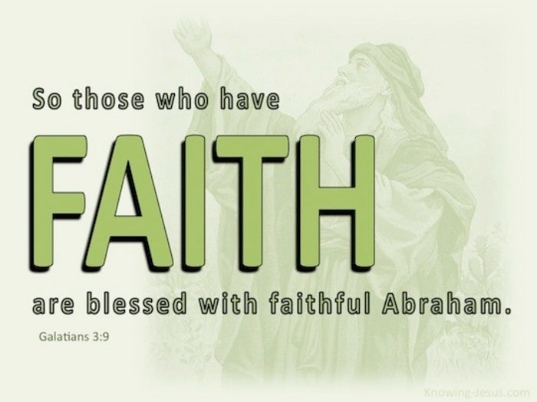

Slide 34
Galatians 3:10 – 14
¹⁰For all who rely on the works of the law are under a curse, as it is written: “Cursed is everyone who does not continue to do everything written in the Book of the Law.” ¹¹Clearly no one who relies on the law is justified before God, because “the righteous will live by faith.” ¹²The law is not based on faith; on the contrary, it says, “The person who does these things will live by them.” ¹³Christ redeemed us from the curse of the law by becoming a curse for us, for it is written: “Cursed is everyone who is hung on a pole [tree].” ¹⁴He redeemed us in order that the blessing given to Abraham might come to the Gentiles through Christ Jesus, so that by faith we might receive the promise of the Spirit.

Slide 35
Galatians 3:10 – 14
Some things are black and white. Not all things, but some things. For example, you’re either married or not married. You can’t be both single and married. Similarly, you’re either alive or dead; there’s no such thing as being both alive and dead (no such thing as the “living dead”).
Some things are just plain black and white. The same is true with the Christian faith. You’re either a Christian or you’re a non-Christian . . . either saved or unsaved. You can’t be both a member of God’s family and not a member of His family. Simply put, you relate to God by grace through faith or you don’t relate to Him at all. It’s a black-or-white issue.

Slide 36
Galatians 3:10 – 14
Another black-or-white issue is the contrast between Law and grace. Swindoll states he has met too many people who think you can gain favor with God by mixing grace and merit, faith and works. Not true! If anybody wants to work for their salvation, they will be required to keep the whole Law perfectly from the moment they take their first breath until the hour of their last.
James 2:10 says, “For whoever keeps the whole law and yet stumbles in one point, he has become guilty of all.” That’s it. Game over. Paradise lost. The moment a person breaks the Law, he or she fall under the judgment of the Law, something Paul calls “the curse of the Law” (3:13).

Slide 37
Galatians 3:10 – 14
Paul continues his argument from the OT in order to champion the life of faith. He explains that the Law, rather than adding anything to salvation, actually nullifies righteousness. Why? Because all people, including those who try to live by the Law, inevitably stumble in many ways. Even the OT itself declares, “There is not a righteous man on earth who continually does good and who never sins” (Eccl. 7:20).
Therefore, instead of establishing their perfect righteousness, the Law places its followers under a penalty, as Paul wrote in Romans: “The wages of sin is death” (Rom. 6:23).

Slide 38
Galatians 3:10 – 14
Here in Galatians, Paul closely paraphrases a passage from Deuteronomy to demonstrate that the Law itself demands absolute righteousness: “Cursed is he who does not confirm the words of this law by doing them” (Deut. 27:26). Note that Paul applies this curse of condemnation to “as many as are of the works of the Law” (3:10).
Both Paul and James argue that those who keep one part of the Law as a rule for a God-pleasing life are obligated to keep it all. We have no right to pick and choose which rules and regulation to follow. This was, in fact, what the Judaizers were doing—to an extreme! Not only did they see the Law as a rule of life for sanctification, but they believed it had to be followed even for salvation.

Slide 39
Galatians 3:10 – 14
As they mixed faith in Christ with the Law, they were selecting some things, like circumcision, and doing away with others, like animal sacrifice. But because the Law is a complete unit of legislation, if we are to have righteousness from the Law we must keep every commandment of the covenant perfectly. If we fail in even the smallest command, we have become Law-breakers and fall under its condemnation.
Paul’s point, then, is that all people who fail to keep the Law in its entirely live under the shadow of God’s impending judgment. How different this is from the Judaizers’ deceptive “pick and choose” approach to the Law! They thought their pursuit of certain aspects of the Law would earn God’s favor.

Slide 40
Galatians 3:10 – 14
The OT not only demonstrates the folly of selective obedience to the Law and announces God’s judgment for failing to keep it entirely but also point to justification by faith even after the Law was given. In Gal. 3:11, Paul quotes Habakkuk: “Now that no one is justified by the Law before God is evident; for, ‘The righteous man shall live by faith.’”
In the original context of Habakkuk, God had just revealed that the southern kingdom (Judah) was going to fall to the Babylonians. The news stunned Habakkuk, but God reassured him that Babylon itself would not go unpunished. That cruel kingdom would triumph for a time by its strength, but God would have the ultimate triumph.

Slide 41
Galatians 3:10 – 14
God’s people, those who trusted in Him no matter how bleak the circumstances, would be delivered by their sovereign God. Paul’s point? Without faith, keeping the external stipulations of the Law was profitless. Even Israel in the OT, living under the Law was a national covenant, was delivered from its curse by faith!
Similarly, eternal life comes not to those who proudly seek salvation by keeping the Law but to the humble, who recognize their need for a righteous substitute and put their complete trust in Him.

Slide 42
Galatians 3:10 – 14
At this point you can almost picture the Galatians: arms crossed, staring skeptically at Paul. Looking down their noses, they respond, “Okay, Paul. You’ve made your point. But wouldn’t faith plus works be even better than faith alone. Wouldn’t grace plus the Law actually improve the Christian life rather than diminish it? After all, the Law came from God, too, just like the gospel!”
Paul makes it clear that the works of the Law cannot blend with the gospel of salvation by grace through faith. The two are mutually exclusive: “The Law is not of faith” (3:12). In contrast to Habakkuk’s statement that “the righteous shall live by faith,” the Law declares “he who practices the commandments shall live by them” (3:12).

Slide 43
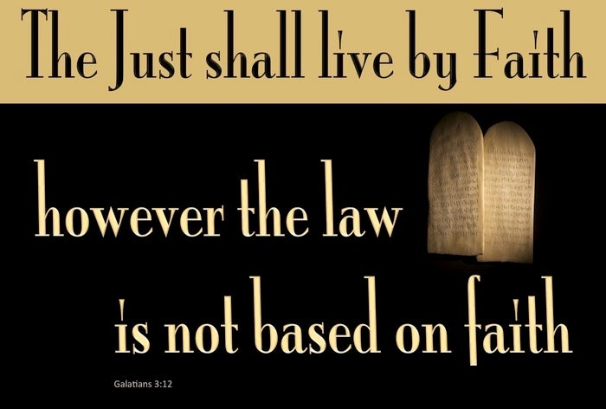

Slide 44
Galatians 3:10 – 14
This is one of those black and white issues. You’re either saved by grace through faith or by the works of the Law. It can’t be both. Yet before you opt out of grace and try the Law route, you need to understand something. Because it’s impossible for us to perfectly fulfill the requirements of the Law, those who choose that route will end up condemned.
So, those who attempt to be saved—or, really, to save themselves—by any means other than by grace through faith fool themselves. Instead of receiving a blessing as a result of their efforts to obey the Law, they fall under a curse. So how does faith remove us from this curse of the Law?

Slide 45
Galatians 3:10 – 14
Paul tells us that Christ, live a perfect, righteous life without even the slightest sin, nevertheless He suffered the curse of the Law (3:13). By suffering death “on a tree,” that is, a cross of wood, Jesus Christ experienced the kind of death the Law reserves for one who is cursed.
To validate this point, Paul alludes to a principle found in Deuteronomy 21:22-23 > “If a man has committed a sin deserving of death, and he is put to death, and you hang him on a tree, ²³his body shall not remain overnight on the tree, but you shall surely bury him that day, so that you do not defile the land which the Lord your God is giving you as an inheritance; for he who is hanged is accursed of God.”

Slide 46
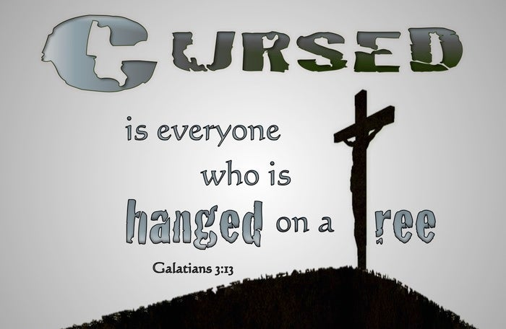

Slide 47
Galatians 3:10 – 14
Though Jesus Christ was the only one ever to fulfill the Law perfectly, He voluntarily submitted to a punishment associated with cursed sinners. Yet he didn’t die as a result of His own sin, but as a substitute for those who actually deserved such punishment—you and me.
The Greek word for “redeemed” in 3:13, is related to the Greek word for “marketplace” which refers to purchasing or ransoming a person, as a slave might be purchased from the slave market. Though we were once in bondage to the Law and under its constant condemnation, Christ’s death in our place has paid the price for our release, freeing us from the curse of the Law and releasing us to serve Christ in a new life of grace.

Slide 48
Galatians 3:10 – 14
The eternal Son of God—sinless, glorious, holy—slipped out of His perfect heaven and into a sin-infested world. He voluntarily took what we deserved, the judgment of God against sin, and gave us what we could never earn: a right standing before God. Why? Paul closes this section with two reasons for the steep price Christ paid to purchase those who believe.
First – Christ purchased us to bestow upon us the blessing of salvation promised to Abraham in Genesis 12:3.
Second – Christ redeemed us so that He could grant us the gift of the Holy Spirit through faith.

Slide 49
Galatians 3:10 – 14
In His plan of salvation, God did not need to relax one letter of His perfect Law to accommodate us wretched sinners who couldn’t get through a day without breaking it. Instead, He sent His Son to fulfill every jot and tittle of the Law for us and to suffer the Law’s sentence of death for us.
Why, then, would anybody once saved by grace through faith in the finished work of Christ seek their own righteousness in the Law—which Christ has already fulfilled? To backslide into legalism would be an affront to the gospel and to the God who alone saves us by His grace.

Slide 50

Antidotes for Backsliding
Application: Chapter 3:1 – 14

Slide 51
Galatians 3:1 –14 Antidotes for Backsliding
Paul‘s hard-hitting assesssment of and argument against backsliding from grace leaves us with three lessons we dare not ignore . . .
[1] – Salvation is a free gift; don‘t try to earn it.
  Adding to the gospel of grace only confuses things. Attempting to earn salvation by any degree robs God of His glory. God is graciously holding out His hand and saying, simply, “Take it. It’s a free gift. You do nothing for it. You owe Me nothing in return.”

Slide 52
Galatians 3:1 –14 Antidotes for Backsliding
[1] – Salvation is a free gift; don‘t try to earn it.
  Since that is true, accept it. Accept the gift once and for all through an act of simple faith. Then continue accepting it each day as you stand firmly on the truth that your salvation from first to last—justification, sanctification, and glorification—is yours as a gift from His hand.
  Rely totally on the finished work of Jesus Christ. He did it all for you.

Slide 53
Galatians 3:1 –14 Antidotes for Backsliding
[2] – Legalism is an aggressive enemy;
don‘t make friends with it.
  When you spot legalism in any form, get away from it. Whether it’s legalistic justification or legalistic sanctification, shun it. Don’t give it a hearing.
  Legalism will make a rational appeal, quoting Bible verses (out of context) that extol the virtues of the Law and the goodness of works. It will also tug at emotions like fear—fear of “anything goes” living or anxiety about pleasing God. We all need to decide that we’re going to walk with the Spirit of God, keeping legalism at arm’s length.

Slide 54
Galatians 3:1 –14 Antidotes for Backsliding
[3] – Backsliding is temporary insanity;
don‘t attempt to reason with it.
  Paul called the Galatians “foolish” for backsliding from grace and suggested they had been “bewitched” (3:1). Swindoll states “throughout his life he have simply confronted error and then backed off and allowed the Spirit of God to do His work.
  Why? Because arguing with insanity is insane. Only God can give wisdom instead of folly. Only His Spirit can break the spell with clarity.

Slide 55
Galatians 3:1 –14 Antidotes for Backsliding
[3] – Backsliding is temporary insanity;
don‘t attempt to reason with it.
  Even your best arguments will not convince a backslidden person who has fallen from grace and gotten stuck in a legalistic way of thinking.
  The ultimate answer? Pray. Take your stand, point out the truth, then pray that God will do His transforming work.

Slide 56

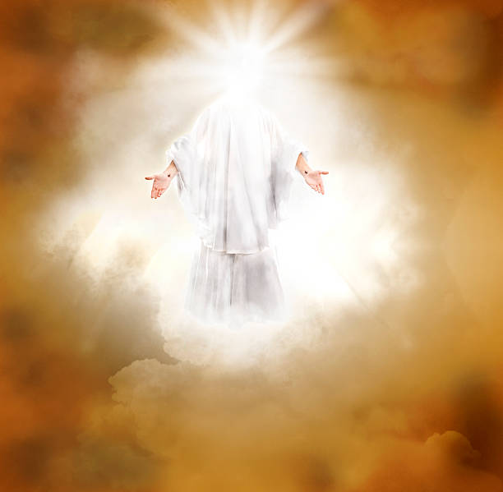

Slide 57
NEXT CLASS – 2 March 2022
Book of Galatians
Before next class, read the below verses in the KJV and the NIV, plus one additional versions of the Bible, i.e., NRSV, NLT, NKJV, etc …
Chapter 3:15 – 22
“A Promise You Can Count On”
EBC Website for Handouts
https://bit.ly/surveyofpaulineepistles

